Slide 1
HOUSE PRICE PREDICTOR

Slide 2
“Fairness is what justice really is ”
-Potter Stewart

Slide 3
WHY THIS PROJECT !?

Slide 4
THE PROBLEM :
Normally house price is decided based on negotiation between seller and buyer. But there is a better way to decide price of a house. There are many factors which affect the price. For example, locality, average price in the locality, availability of transport, availability of health-care nearby, distance from schools, offices etc.

Slide 5
THE CHALLENGE
TO PROVIDE FAIR PRICE TO BOTH PARTIES , BY USING VARIOUS MACHINE LEARNING TECHNIQUES
THE REAL CHALLENGE IS TO FIND/CREATE AN ACCURATE DATASET WITH CORRECT VALUES OF VARIOUS PARAMETERS

Slide 6
EXPECTED OUTCOME
A machine learning based software which takes values of decisive factors as input and outputs the estimated price

Slide 7
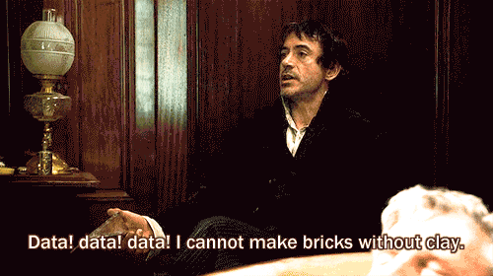
WELL WELL WELL LOOK WHAT SHERLOCK HAD TO SAY …

Slide 8
A UNIQUE DATASET

Slide 9
THE SOLUTION
IMPLEMENTING OUR CONCEPT TO CREATE A SYSTEM (A MEDIUM) TO ENSURE BOTH THE BUYER AND THE SELLER KNOW THE FAIR PRICE OF THEIR PROPERTY

Slide 10
CONCEPT
TRAIN A MODEL USING MACHINE LEARNING ALGORITHMS

Slide 11
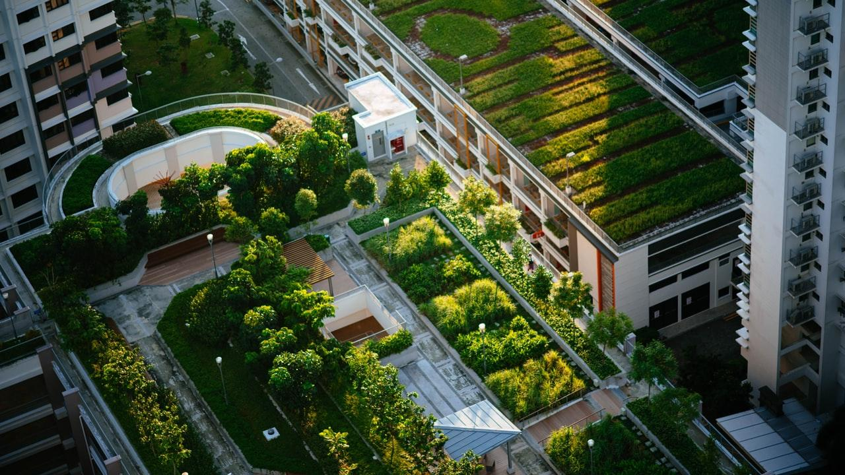
THIS CAN BE YOU !

Slide 12
TYPE OF REGRESSION | ACCURACY
DECISION TREES | ~93%
RANDOM FOREST | ~53%
MULTIPLE LINEAR | ~9%
LINEAR | NA

Slide 13
ML BASED HOUSE PRICE PREDICTORS EXIST HERE
COMING UP !

Slide 14
245,861
Whoa! that’s the total number of houses sold in India in 2019

Slide 15
89,526,124$
185,244 users
100%
That’s a lot of money
And a lot of users (ML based properties bought online)
Total success of our model !

Slide 16
OUR PROCESS IS EASY
STEP -1
STEP -2
STEP -3
STEP -4
THE DATASET
MODEL CREATION
MODEL TRAINING
& TESTING
THE PREDICTIONS
THE FIRST SET IS TO CREATE , CLEAN AND OPTIMIZE THE DATASET.
CREATE A MODEL BASED ON AN INTERNAL COREALATION MATRIX .
USE VARIOUS MlL ALGO’S TO PROPERLY TRAIN OUR MODEL REPEAT PROCESS UNTILL HIGHEST ACCURACY IS ACHIEVED,
THE FINAL STAGE IS GETTING THE PREDICTIONS FROM OUR MODEL

Slide 17
DESKTOP PROJECT
SS OF WEBSITE
Show and explain your web, app or software projects using these gadget templates.

